Slide 1
How are programmes specifically designed using collected data?
Osamu Kunii, MD, MPH, PhD
Head, Strategy, Investment and Impact Division
The Global Fund to fight AIDS, Tuberculosis and Malaria

Slide 2
Outline
Data Use for Action and Improvement Framework (DUFAI)
Data Use for fund allocation
Data Use for across the grant lifecycle
Data and Analytics (DnA) for grant management
Data Use for policy change and implementation adjustment

Slide 3
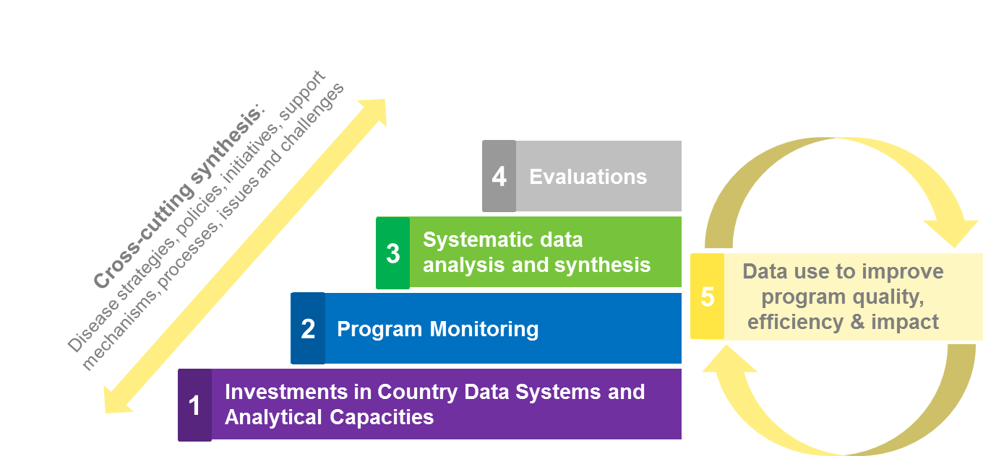
Data Use for Action and Improvement (DUFAI) Framework
To strengthen data availability, quality and use of data for program improvement and maximized impact
20 indicators/targets

Slide 4
DUFAI: Integration and Alignment across the metrics
Data Use for action and Improvement (DUFAI)
Risk management
GF Strategy and Strategic Priorities
KPI framework
Key metrics and sources of funding (OPEX, Grants)
Notes:
This framework consolidates all reporting requirements, including KPI, Strategic Implementation plan, risk tracer indicators, and key metrics

Slide 5
Strategic Performance Framework (KPI 2017-22)
Funding
Program Design
Implementation
Impact /
Results
Lower
How is
global
effort
performing?
1
KPI 1: Impact
KPI 2: Service delivery
KPI 9c: Human Rights & Key Pops in UMICs
KPI 4: Investment efficiency
KPI 5: KPs
srvc. coverage
KPI 6: RSSH
(a, b, c, d, e)
How are
countries we
are supporting performing?
2
KPI 11: Domestic
investments
KPI 6f: NSP Alignment
KPI 8: Gender
& age equality
KPI 9a: HRts barriers
GF accountability
KPI 9b: Human Rights &
Key Pop in MICs
KPI 7b: Absorptive capacity
How are our grants
performing?
3
KPI 10: Resource mobilization
KPI 3: Alignment of investment & need
KPI 7a: Allocation utilization
4
How are GF grant operations performing?
KPI 12: Availability of affordable health tech
Higher
How are internal Secretariat operations performing?
5
Data sources
Grant reporting
Country info (from CCM)
Technical partners
Assessments. evaluations
Secretariat internal data

Slide 6
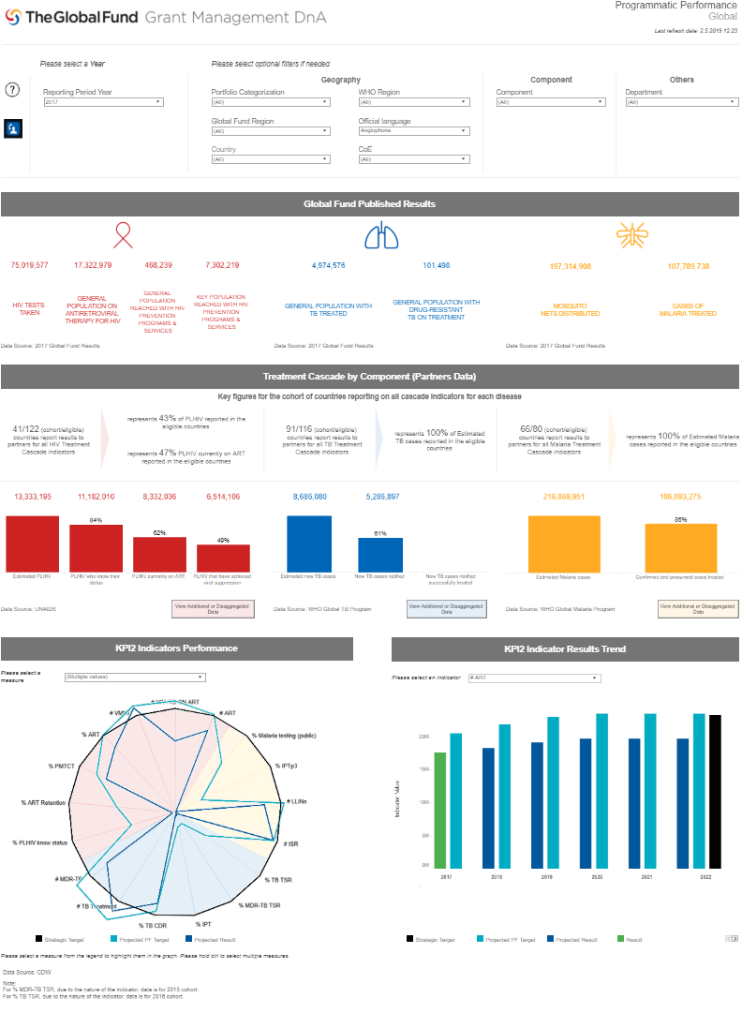
Data and Analytics (DnA): Central interactive portal for grant management data
Global
Region
Country
Grant
General Information
Health Financing
Programmatic Performance
Launched
Financial Performance
Risk
Process
Disease
Future Release
Key Insights
Country Coordinating Mechanism

Slide 7
HIV data used for fund allocation
Allocation Formula
Qualitative Adjustments
Stage 1
Stage 2
Disease burden | Number of people living with HIV
Economic Capacity | Based on GNI per capita
Max / Min Shares | - Max: 10% funding of each disease component; 7.5% of all countries - Min: $500,000 per component
Other External Financing | Projections of other external financing
 | Populations disproportionately affected by HIV
Parameters | Key Populations (HIV incidence, prevalence, size, etc.)
Absorption and impact | Other considerations
Potential for impact and absorption | Cost of essential programming Coverage gaps Risk of malaria resurgence

Slide 8
Data collection and use at various stages of grant lifecycle
Identify gaps
Invest
Implement, track performance
& adjust
Country dialogue
Funding request
Grant making
Year 1
Year 2
Year 3
Epi-analysis ; National program reviews
M&E systems assessment
National strategic plan
Investment cases
Prioritization models
Performance framework
M&E plan
Risk assessment
Strengthen national M&E systems
Progress updates &
Annual Funding Decision
Assessment of Quality
of Data and Programs

Slide 9
Grant ratings and determining annual funding amount
Step 3
Step 1
Step 2
Analysis of
Financial Performance
Analysis of
Program Performance
Indicative
Funding Range
Annual Funding Disburse. Decision
Analysis of
Grant Management Performance
90-100%
a1
C
b2
b1
a2
a1
90-100%
a2
Indicator Rating
60-89%
a1
Exceeding expectations
b1
30-59%
a2
Meets expectations
b2
c
b1
Adequate
TBD
b2
Inadequate
c
Unacceptable
Final Grant Rating

Slide 10
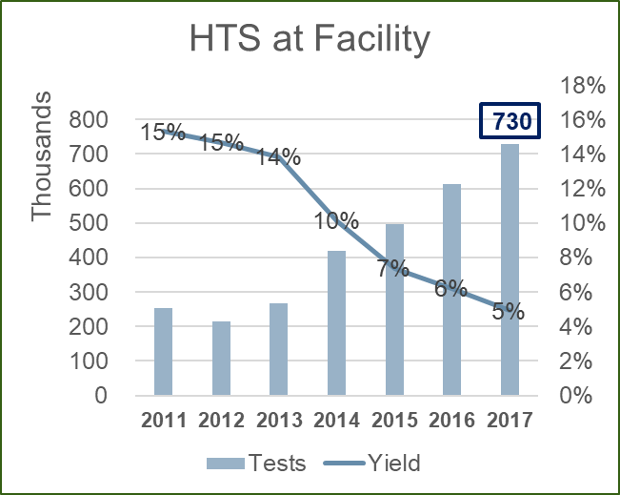
Lesotho : Use data to drive policy change
- High volume of tests
- High rate of repeated tests
- Declining yield
- Increasing cost of
implementation
-Targeted groups
- Differentiated service
delivery
- Focused on high yield
modalities with yield
targets
- Regular data analysis and
adjustment

Slide 11
Community-based monitoring
Advantage: bottom-up, demand side, community engagement & buy-in, shorter, local feedback loops
Example: Community Tx Observatory in 11 countries, West Africa
€3.6 million to International Treatment Preparedness Coalition
Findings: stock-out, reasons for not accessing ART, quality of care, out-of-pocket payment
Actions: advocacy and improvement for differentiated service delivery, non-facility based HIV testing, communication to prevent stock-outs, funding to viral load testing machines/lab supplies

Slide 12
Way forwards
Smarter investment in in-country data systems
GF replenishment and domestic resource mobilization
Strategic partnership for acceleration toward SDGs

Slide 13
Acknowledgment
HIV Team
Monitoring, Evaluation and Country Analysis Team
Lesotho Country Team
Jinkou Zhao, Lee Abdelfadil, Michelle Monroe
Gavin Reid,

